Slide 1

Chapter 8: Physical Database Design and Performance
Modern Database Management

Slide 2
Part 1: Objectives
Describe the physical database design process
Choose storage formats for attributes
Know when and how to use denormalization
Describe three types of file organization
Select appropriate file organizations
Describe indexes and their appropriate use
Translate a database model into efficient structures

Slide 3
Part 2: Objectives
Describe problems and techniques for data security
Describe problems and facilities for data recovery
Understand impact of cloud-based database services on database infrastructure

Slide 4
Part 1: Physical Database Design

Slide 5
Physical Database Design
Purpose – Translate the logical description of data into the technical specifications for storing and retrieving data
Goal – Create a design for storing data that will provide adequate performance and ensure database integrity, security, and recoverability

Slide 6
Physical Database Design and Regulatory Compliance
The control of database integrity is the foundation of regulatory compliance
Sarbanes-Oxley Act (SOX) – Protect investors by improving accuracy and reliability
The increasing demands for accuracy and reliability of financial data and corporate disclosures
Some preventive controls can be designed into the database and enforced by the DBMS
Three areas of SOX audits
I T change management
Logical access to data
Security procedures to prevent unauthorized access
Personnel controls and physical access controls
I T operations

Slide 7
Information Needed for Physical Design
Normalized relations, including estimates for the range of the number of rows in each table
Definitions of each attribute, along with physical specifications such as maximum possible length
Descriptions of where and when data are used in various ways (entered, retrieved, deleted, and updated), including typical frequencies of these events
Expectations or requirements for response time and data security, backup, recovery, retention, and integrity
Descriptions of the technologies (database management systems) used for implementing the database
Notes:
Much of the input to the physical design comes from outputs from requirements analysis and logical design. Others stem from business security concerns and regulatory compliance, while still others stem from predictions of demand and performance analysis.

Slide 8
Key Decisions in Physical Database Design
Choosing the storage format (data type) for each attribute from the logical data model
Grouping attributes from the logical data model into physical records
Arranging similarly structured records in secondary memory (primarily hard disks) so that individual and groups of records can be stored, retrieved, and updated rapidly (i.e. file organizations)
Selecting structures for storing and connecting files to make retrieving related data more efficient (i.e. indexes and database architectures)
Preparing strategies for handling queries against the database that will optimize performance

Slide 9
Summary – Physical Design Process
Inputs
Decisions
Normalized relations
Volume estimates
Attribute definitions
Response time expectations
Data security needs
Backup/recovery needs
Integrity expectations
DBMS technology used
Storage format (attribute data types)
Physical record descriptions (how to group attributes; doesn’t always match logical design)
File organizations
Indexes and database architectures
Query optimization
Leads to

Slide 10
Decision 1: Designing Fields

Slide 11
Designing Fields (Choosing storage formats for attributes)
Field: smallest unit of data in database
Field design many include:
Choosing data type
Coding, compression, encryption
Controlling data integrity
Mechanisms to handle missing values

Slide 12
Choosing Data Types
A data type is a detailed coding scheme recognized by DBMS to represent data.
Factors to be considered
Representing all possible values
Improve data integrity
Support all data manipulations
Minimize storage space

Slide 13
Field Data Integrity – Examples ???
Default value – assumed value if no explicit value
Range control – allowable value limitations (constraints or validation rules)
Null value control – allowing or prohibiting empty fields
Referential integrity – range control (and null value allowances) for foreign-key to primary-key match-ups

Slide 14
Handling Missing Data
Substitute an estimate of the missing value (e.g., using a formula)
Construct a report listing missing values
In programs, ignore missing data unless the value is significant (sensitivity testing)
Triggers can be used to perform these operations

Slide 15
Decision 2: Designing Physical Records

Slide 16
Designing Physical Records
Physical Record: A group of fields (columns) stored in adjacent memory locations and retrieved together as a unit
Factors influencing physical record design
With the rapid decline in the cost of secondary storage, the efficient use of storage space is a relevant factor but becomes less important
The most important factor is efficient data processing (minimize the time required for users to interact with the information system)
Techniques to improve the efficiency of data processing
Denormalization
Partitioning

Slide 17
Denormalization
Denormalization: Transforming normalized relations into non-normalized physical record specifications
Why denormalization?
A fully normalized database usually creates a large number of tables (relations)
Implementing each one for one as physical records may not yield efficient data processing
Sometimes data from different relations are needed together to answer a frequently used query or produce a report, for which the DBMS needs to spend considerable computer resources to look for and match up related rows from each table

Slide 18
Benefits and Risks of Denormalization
Benefits:
Can improve performance (speed) by reducing number of table lookups (i.e. reduce number of necessary join queries)
Costs (due to data duplication):
Wasted storage space
Data integrity/consistency threats

Slide 19
Common Denormalization Opportunities
One-to-one relationship (example: slide 20)
Many-to-many relationship with non-key attributes (associative entity) (example: slide 21)
Reference data (1:N relationship where 1-side has data not used in any other relationship) (example: slide 22)

Slide 20
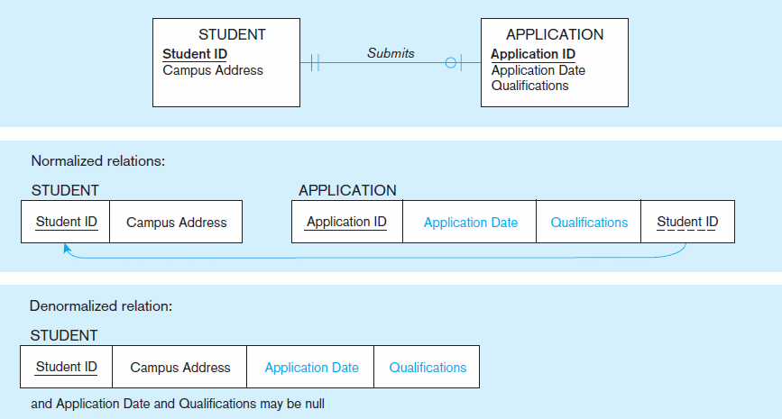
Figure 8-3: A possible denormalization situation: two entities with one-to-one relationship

Slide 21
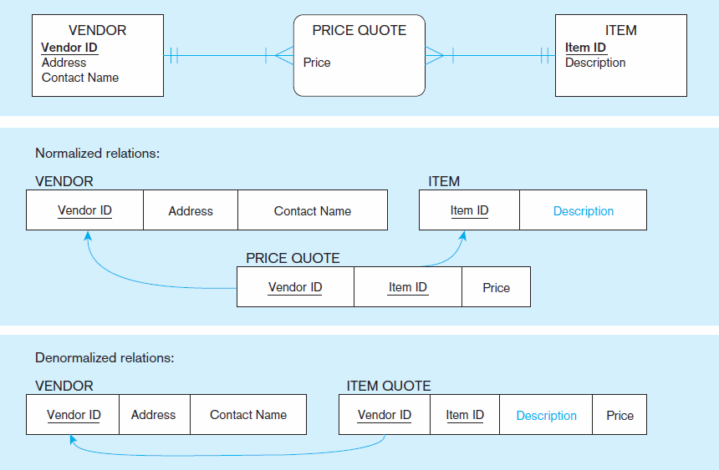
Figure 8-4: A possible denormalization situation: a many-to-many relationship with non-key attributes
Extra table access required
2NF
Null description possible

Slide 22
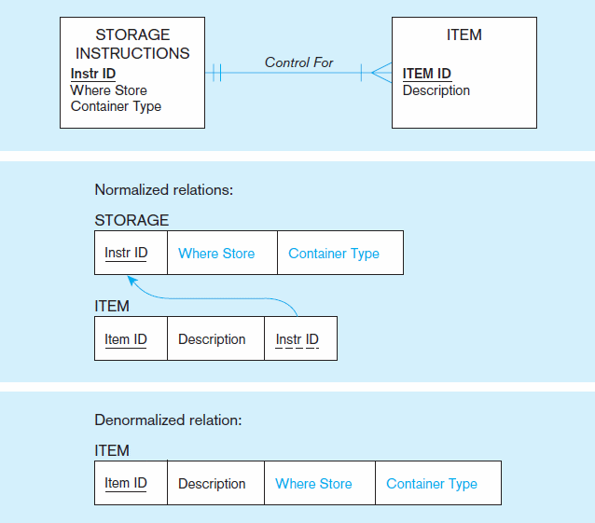
Figure 8-5: A possible denormalization situation: reference data
Extra table access required
Data duplication

Slide 23
Caution with Denormalization
Denormalization can
Increase chance of errors and inconsistencies
Reintroduce anomalies
Force reprogramming when business rules change
Perhaps other methods could be used to improve performance of joins
Organization of tables in the database (file organization and clustering)
Proper query design and optimization

Slide 24
Partitioning
Horizontal Partitioning: Distributing the rows of a table into several separate files
Useful for situations where different users need access to different rows
Key Range Partitioning, Hash Partitioning, List Partitioning, or Composite Partitioning
Vertical Partitioning: Distributing the columns of a table into several separate relations
Useful for situations where different users need access to different columns
The primary key must be repeated in each file
Combinations of Horizontal and Vertical
Partitions often correspond with User Schemas (user views)

Slide 25
Partitioning Pros and Cons
Advantages of Partitioning:
Efficiency: Records used together are grouped together
Local optimization: Each partition can be optimized for performance
Security: data not relevant to users are segregated
Recovery and uptime: smaller files take less time to back up
Load balancing: Partitions stored on different disks, reduces contention
Disadvantages of Partitioning:
Inconsistent access speed: Slow retrievals across partitions
Complexity: Non-transparent partitioning
Extra space or update time: Duplicate data; access from multiple partitions

Slide 26
Decision 3: Designing Physical Files

Slide 27
Designing Physical Files
Physical File: A named portion of secondary memory allocated for the purpose of storing physical records
File Organization: Technique for physically arranging records of a file on secondary storage
Factors for selecting file organization:
Fast data retrieval and throughput
Efficient storage space utilization
Protection from failure and data loss
Minimizing need for reorganization
Accommodating growth
Security from unauthorized use
These factors are usually in conflict.

Slide 28
Types of file organizations
Sequential file organization
Indexed file organization
Hashed file organization

Slide 29
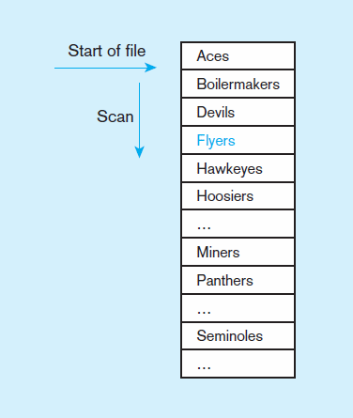
Type 1: Sequential File Organization
Records of the file are stored in sequence by the primary key field values
1
2
If sorted – every insert or delete requires resort
If not sorted
Average time to find desired record = n/2
n

Slide 30
Type 2: Indexed File Organizations
Indexed File Organization: the storage of records either sequentially or nonsequentially with an index that allows software to locate individual records
Index: a table or other data structure used to determine in a file the location of records that satisfy some condition
Primary keys are automatically indexed
Other fields or combinations of fields can also be indexed; these are called secondary keys (or nonunique keys)

Slide 31
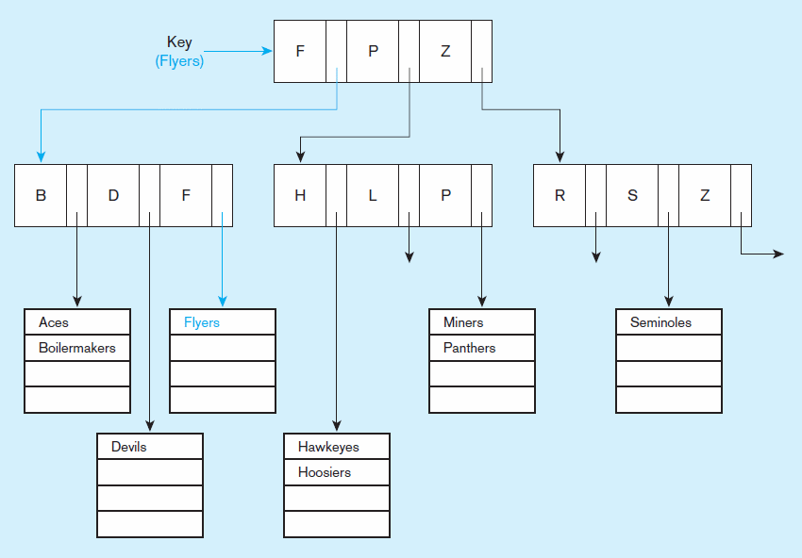
Figure 8-7b. An Example of Indexed File Organization
uses a tree search
Average time to find desired record = depth of the tree

Slide 32
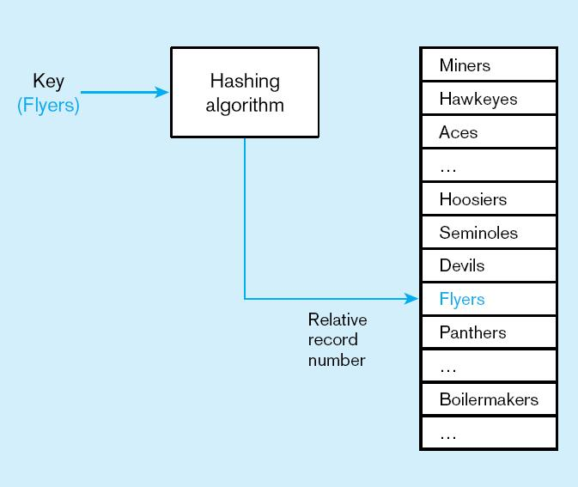
Type 3: Hashed File Organization
In a hashed file organization, the address of each record is determined using a hash algorithm.
A hash algorithm is a routine that coverts a primary key value into a record address.
Hash algorithm
Usually uses division-remainder to determine record position. Records with same position are grouped in lists.

Slide 33
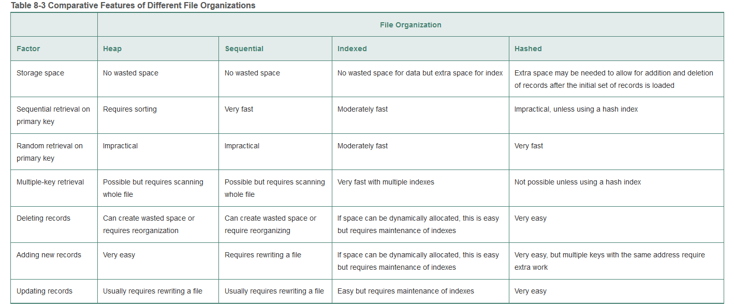

Slide 34
Clustering Files
In some relational D B M S s, related records from different tables can be stored together in the same disk area
Useful for improving performance of join operations
Primary key records of the main table are stored adjacent to associated foreign key records of the dependent table
e.g. Oracle has a CREATE CLUSTER command
34

Slide 35
Join Indexes: speed up join operations
A join index is an index on columns from two or more tables that come from the same domain of values.
A joint index saves query processing time by finding data meeting a pre-specified qualification (at the expense of extra storage space and index maintenance).

Slide 36
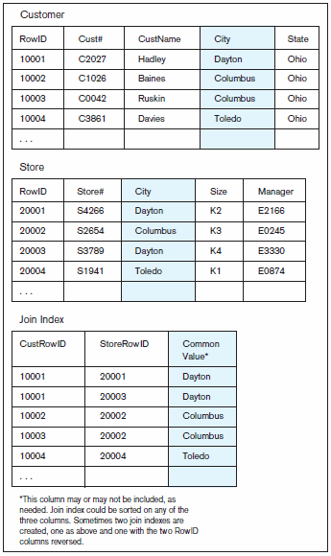
Join Indexes – Example 1
Example 1: Join index for common non-key columns

Slide 37
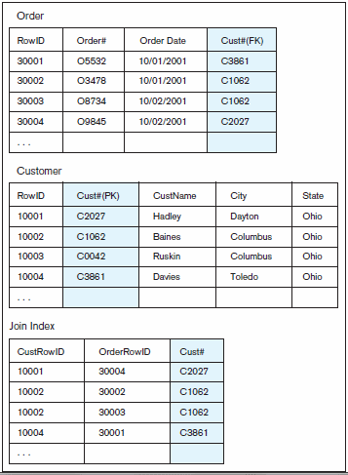
Join Indexes – Example 2
Example 2: Join index for matching foreign key (FK) and primary key (PK)

Slide 38
Decision 4: Selecting Structures for Storing and Connecting files
Using and Selecting Indexes

Slide 39
Rules for Using Indexes
Use on larger tables
Index the primary key of each table
Index search fields (fields frequently in WHERE clause)
Fields in SQL ORDER BY and GROUP BY commands
When there are >100 values but not when there are <30 values

Slide 40
Rules for Using Indexes (cont.)
Avoid use of indexes for fields with long values; perhaps compress values first
If key to index is used to determine location of record, use surrogate (like sequence nbr) to allow even spread in storage area
DBMS may have limit on number of indexes per table and number of bytes per indexed field(s)
Be careful of indexing attributes with null values; many DBMSs will not recognize null values in an index search

Slide 41


Unique and Non unique Indexes
Unique (primary) Index
Typically done for primary keys, but could also apply to other unique fields
Non unique (secondary) index
Done for fields that are often used to group individual entities (e.g., zip code, product category)
Notes:
Part of the physical design process is to decide which fields need indexing. Primary keys are normally indexed by default. The database designer typically chooses which other fields to index, based on expected usage of those fields in queries and inserts. If the fields are used a lot as conditions in queries, this increases the importance of indexing. But indexing comes at a cost, which involves maintaining the index. Indexes are costly for fields that get updated a lot.

Slide 42
Decision 5: Query Optimization

Slide 43
Query Optimization
Parallel query processing–possible when working in multiprocessor systems
Overriding automatic query optimization–allows for query writers to preempt the automated optimization
Picking data block size–factors to consider include:
Block contention, random and sequential row access speed, row size
Balancing I/O across disk controllers

Slide 44
Part 2: Database Security, Backup, and Recovery

Slide 45
Database Software Security Features
Views or subschemas
Integrity controls
Authorization rules
User-defined procedures
Encryption
Authentication schemes
Backup, journalizing, and checkpointing

Slide 46

Views
Views
Subset of the database that is presented to one or more users
User can be given access privilege to view without allowing access privilege to other tables or even the underlying tables

Slide 47

Integrity Controls
Integrity Controls
Protect data from unauthorized use
Domains – set allowable values
Assertions – enforce database conditions
Triggers – prevent inappropriate actions, invoke special handling procedures, write to log files

Slide 48
Authorization Rules
Authorization rules: Controls incorporated in the data management system
Restrict:
Access to data
Actions that people can take on data
Authorization matrix for:
Subjects
Objects
Actions
Constraints
Subject | Object | Action | Constraint
Sales Dept. | Customer record | Insert | Credit limit L E $5000
Order trans. | Customer record | Read | None
Terminal 12 | Customer record | Modify | Balance due only
Acctg. Dept. | Order record | Delete | None
Ann Walker | Order record | Insert | Order a m l L T $2000
Program A R4 | Order record | Modify | None
Notes:
Authorization rules grant subjects access to objects, specifying which actions and constraints govern the subjects’ access.
Subjects are users or groups of users. Objects are entities in the database. Actions are the types of DML commands permitted for a given subject on a given object (SELECT, INSERT, UPDATE, DELETE). And these actions can be further constrained, based on the authorization rule.
All of these are available to the DBA to control via the DBMS software.
Here we see these rules expressed as an authorization matrix (figure 8-9).

Slide 49
Figure 8-10 Implementing Authorization Rules
a) Authorization table for subjects (salespersons)
Blank | Customer records | Order records
Read | Y | Y
Insert | Y | Y
Modify | Y | N
Delete | N | N
b) Authorization table for objects (orders)
Blank | Salespersons (password BATMAN) | Order entry (password JOKER) | Accounting (password TRACY)
Read | Y | Y | Y
Insert | N | Y | N
Modify | N | Y | Y
Delete | N | N | Y
Notes:
These authorization tables are simplified representations of authorization rules. One is for subjects and the other is for objects.
The key idea in both authorization matrices and authorization tables is that you are controlling who gets what kind of access to which data elements.
Privileges are granted for different database activities: select, insert, update, delete, alter, index, references, and procedure/function execution.

Slide 50
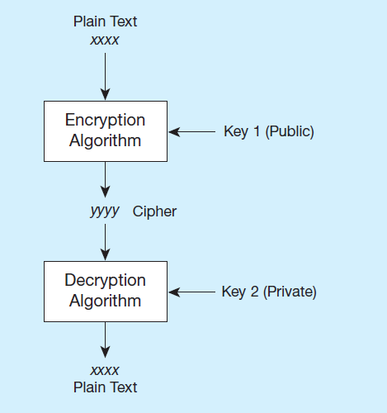
Basic Two-Key Encryption
Encryption – the coding or scrambling of data so that humans cannot read them
Secure Sockets Layer (S S L) is a popular encryption scheme for T C P/I P connections.
Notes:
Some DBMS products include encryption routines that automatically encode sensitive data when they are stored or transmitted over communications channels. For example, encryption is commonly used in electronic funds transfer (EFT) systems. Other DBMS products provide exits that allow users to code their own encryption routines.

Slide 51
Authentication Schemes (1 of 2)
Goal – obtain a positive identification of the user
Passwords: First line of defense
Minimum length
Should combine alphabetic and numeric data
Should not be complete words or personal information
Should be changed frequently

Slide 52
Authentication Schemes (2 of 2)
Strong Authentication
Passwords are flawed:
Users share them with each other
They get written down, could be copied
Automatic logon scripts remove need to explicitly type them in
Unencrypted passwords travel the Internet
Possible solutions:
Two factor – e.g., smart card plus P I N
Three factor – e.g., smart card, biometric, P I N

Slide 53
Database Backup and Recovery
Mechanism for restoring a database quickly and accurately after loss or damage
Recovery facilities:
Backup Facilities
Journalizing Facilities
Checkpoint Facility
Recovery Manager
Notes:
Sometimes data is lost or damaged, so DBMSs include facilities for recovering from this lost. Generally this involves backing data up and allowing it to be restored.

Slide 54
Back-up Facilities
D B M S should provide backup facilities that produce backup copy of the entire database or subset, plus control files and journals.
Periodic backup (e.g. nightly, weekly)
Cold backup – database is shut down during backup
Hot backup – selected portion is shut down and backed up at a given time
Backups should be stored in secure, off-site location.
Backups are used to restore the database in the event of hardware failure, catastrophic loss, or damage

Slide 55
Journalizing Facilities
Audit trail of transactions and database updates
Transaction log – record of essential data for each transaction processed against the database
Database change log – images of updated data
Before-image – copy before modification
After-image – copy after modification
In addition, some systems also keep a security log, which can alert the DBA to any security violations that occur or are attempted.

Slide 56
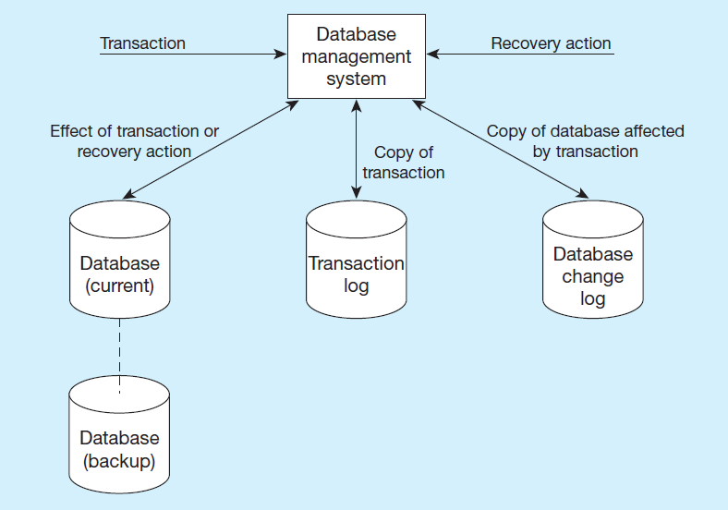
Figure 8-13 Database Audit Trail
From the backup and logs, databases can be restored in case of damage or loss

Slide 57
Checkpoint Facilities
D B M S periodically refuses to accept new transactions
Therefore, the system is in a quiet state
Database and transaction logs are synchronized
This allows recovery manager to resume processing from short period, instead of repeating entire day

Slide 58
Recovery Manager
Recovery Manager – D B M S module that restores the database to a correct condition when a failure occurs and then resumes processing user requests
Recovery and Restart Procedures
Disk Mirroring – switch between identical copies of databases
Restore/Rerun – reprocess transactions against the backup (only done as a last resort because it is time consuming)
Backward Recovery (Rollback) – apply before images; reverse the changes made by transactions that have aborted, or terminated abnormally
Forward Recovery (Roll Forward) – apply after images (preferable to restore/rerun); only the most recent after images need to be applied

Slide 59
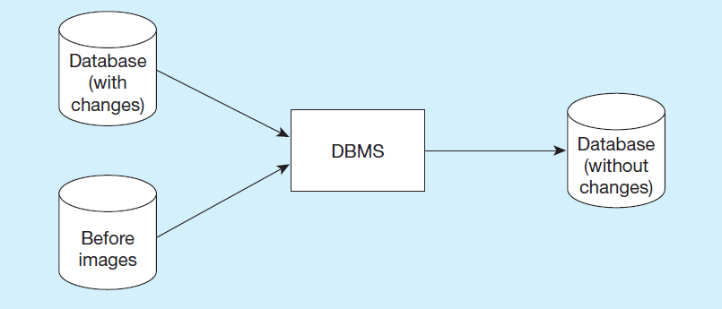
Figure 8-14 Basic Recovery Techniques – Rollback
Notes:
Rollback is the backout, or undo, of unwanted changes to a database. Before images of the records that have been changed are applied to the database, and the database is returned to an earlier state. Rollback is used to reverse the changes made by transactions that have been aborted, or terminated abnormally.
Rollback is a typical means of cancelling transactions when there is an error in the insert/update/deletes.

Slide 60
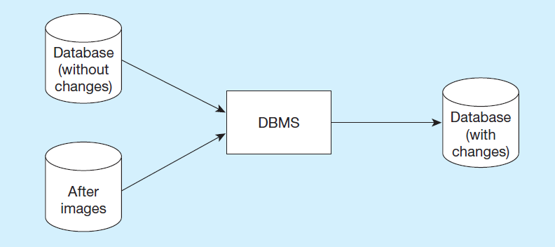
Figure 8-14 Basic Recovery Techniques - Rollforward
Notes:
Rollforward is a technique that starts with an earlier copy of a database. After images (the results of good transactions) are applied to the database, and the database is quickly moved forward to a later state.
This approach is an alternative to restore/rerun. It is much faster and doesn’t require the use of the transaction log and repetition of transactions. Instead, it makes use of database change log. Of course, this requires more up-front activity (maintaining the database change log in addition to the transaction log). But the actual recovery itself, if needed, runs much faster and with more accuracy.

Slide 61
Responses to Database Failures (1 of 2)
Aborted transaction
Rollback (preferred)
Rollforward/return transactions to state just prior to abort
Incorrect data (update inaccurate)
Rollback (preferred)
Reprocess transactions without inaccurate data updates
Compensating transactions
Notes:
In this and the next slide, we see some types of failures and the best recovery techniques to use. Notice that reprocessing transactions is never a preferred option. Notice also that all these are possible because of disk mirroring, backups, and the maintenance of transaction and database change logs. All of these are techniques to make the database “fault tolerant”.

Slide 62
Responses to Database Failures (2 of 2)
System failure (database intact)
Switch to duplicate database (preferred)
Rollback
Restart from checkpoint
Database destruction
Switch to duplicate database (preferred)
Rollforward
Reprocess transactions

Slide 63
Disaster Recovery
Develop a detailed written disaster recovery plan, and test this regularly
Choose and train a multidisciplinary team to carry out the plan
Establish a backup data center at an off-site location, located a sufficient distance from the primary site
Send backup copies of databases to the backup data center on a scheduled basis

